Slide 1


Simulating Large-Scale Vehicular Networks with Statistical Accuracy
Bin Cheng
Joint work with
Ali Rostami, Marco Gruteser
WINLAB, Rutgers University, USA
Supported by
Crash Avoidance Metrics Partnership (CAMP) Vehicle Safety Communications 3 (VSC3) Consortium

Slide 2
Outline
Introduction
Motivation
CAMP field test
Simulating a large-scale vehicular network
  Simulator calibration
  Calibration performance
Conclusion

Slide 3
Introduction
Comparing to experiment-driven methodology, network simulators remain as an important tool for performance evaluation, because
  Lower cost
  Better flexibility and scalability
Network simulators are especially important for large-scale vehicle-to-vehicle communication (V2V) networks
  Because normally too expensive for an researcher to conduct experiments with hundreds or even thousands of vehicles
Notes:
Given the increase of programmable wireless hardware, mobile networking research has shifted over the past decades from a heavy reliance on simulation towards a more experiment-driven methodology

Slide 4
Motivation
Safety-related character of V2V heighten the requirement of simulation accuracy
  Safety applications, e.g., collision avoidance, blind merge warning, emergency electronic brake lights, built based on V2V
  Changes in network performance can translate to the changes in safety application performance
  Simulation accuracy is critical when evaluating the application performance
However, the validity of simulation is frequently questioned for large-scale networks
  Simulation accuracy studied for small-scale networks
This work studied simulation accuracy of large-scale networks based on the data from a series of field tests
Notes:
The primary use of V2V communication is to build safety-related driving applications
Particularly, what we did was to calibrate low-complexity simulations models based on the field test data, and compared the simulation results with the field test results to see how accurate the simulation results can be

Slide 5
Background
Dedicated Short Range Communication (DSRC)
  Selected technology for V2V communication
  Dedicated: 5.850-5.925 GHz licensed spectrum
  Short Range: Hundreds of meters
  Communication: Vehicle-to/from-X, where X =
    Another vehicle (V2V)
    Roadside infrastructure (V2I)
    Pedestrian, bicycle, train, …
  PHY/MAC layer regulated by IEEE 802.11p
    Broadcast-based, no CTS/RTS, no retransmission
DSRC driving safety concepts
  Each vehicle sends safety messages frequently
  Receiving vehicles assess collision threats
  Threats: warns driver or take control of the vehicle

Slide 6
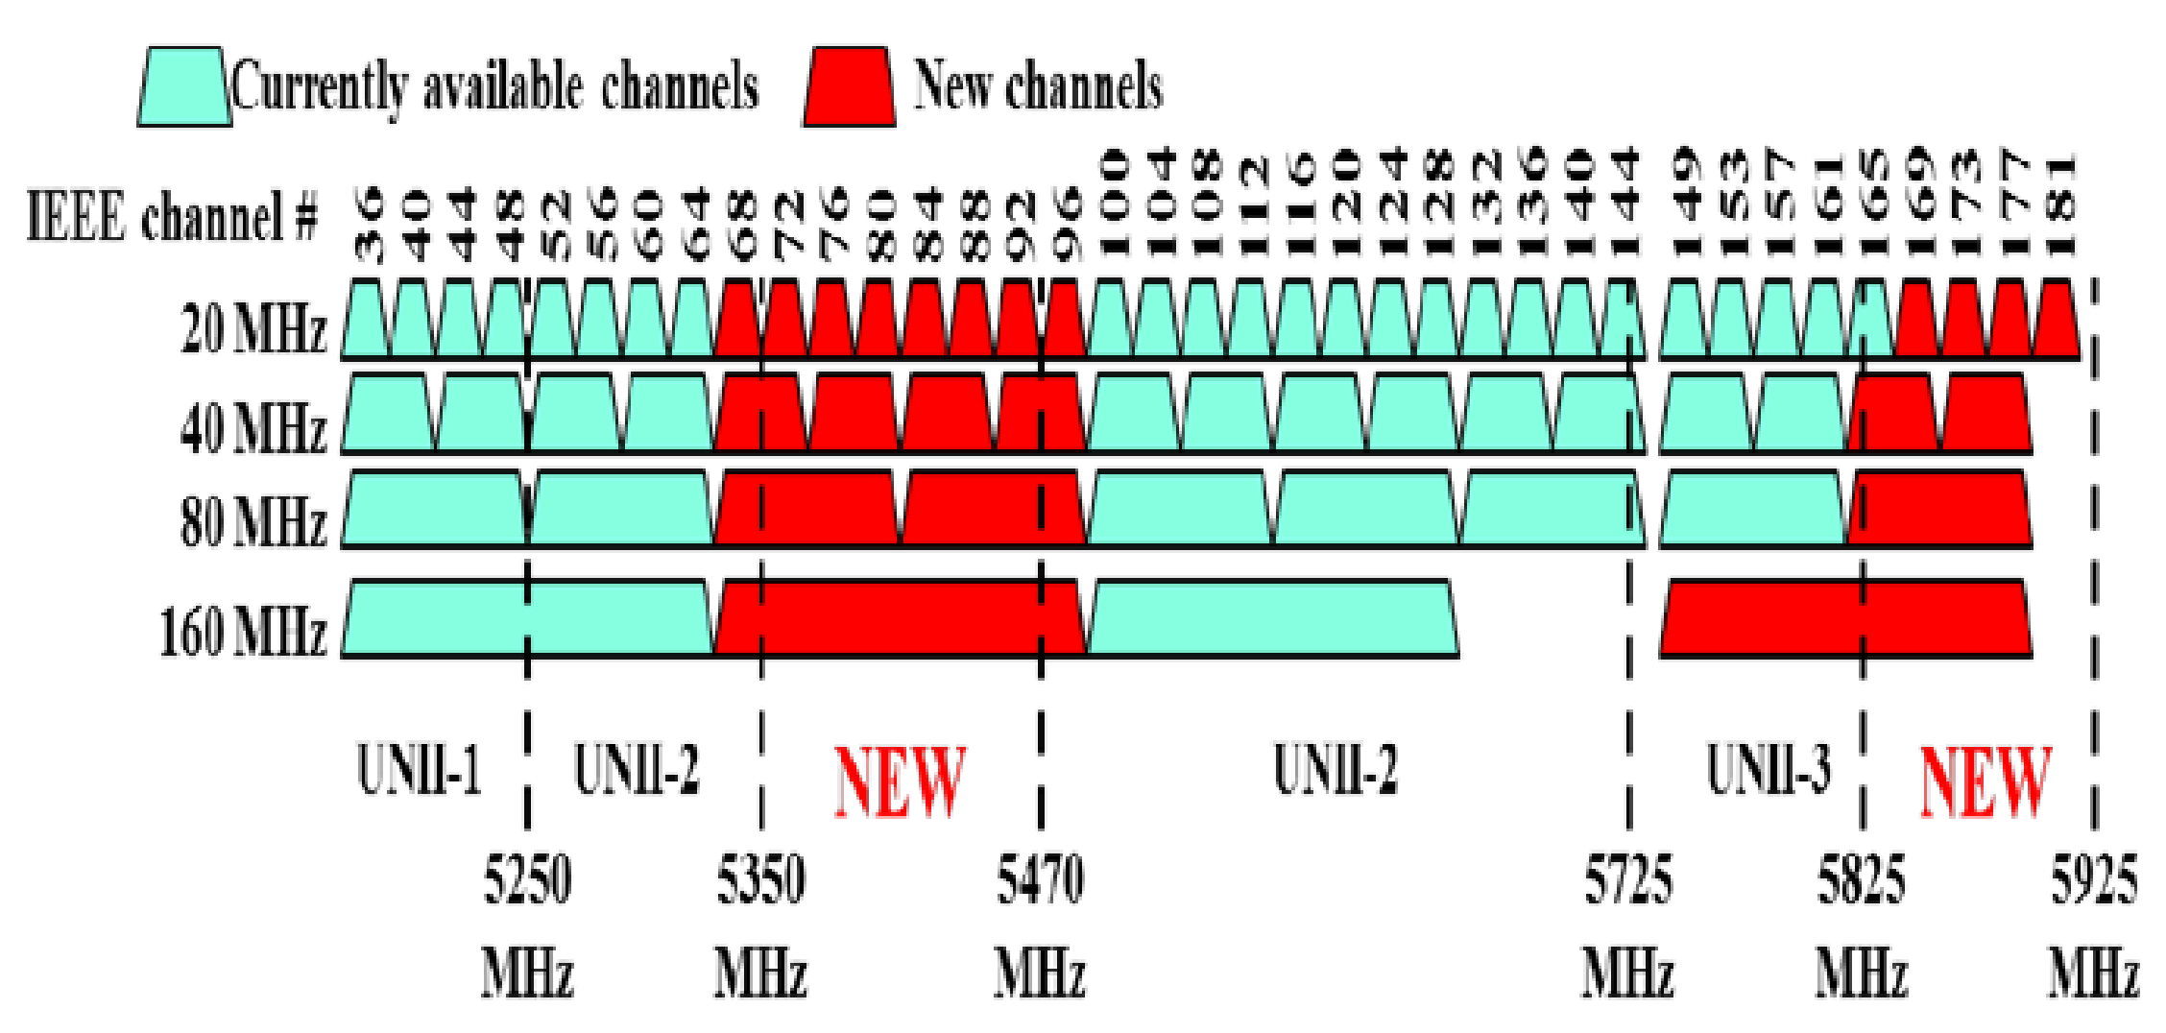
Background
DSRC and WiFi coexistence
  New IEEE 802.11 ac standard potentially add 4 new 80 MHz and 3 new 160 MHz channels in 5 GHz band
    One 80 and one 160 MHz channel in DSRC 5.9 GHz band
DSRC band
Source: Cisco
Notes:
Whether sharing with DSRC is allowed, how to share is still a open problem and after sharing, how much the performance of DSRC is going to degrade, all these questions are still unknown.
We believe an accurate simulation tool can also help to evaluate the DSRC and WiFi coexistence.

Slide 7
CAMP field test
Conducted by the Crash Avoidance Metrics Partnership (CAMP) Vehicle Safety Communications 3 (VSC3) Consortium, in partnership with USDOT
Focus on performance of a large-scale DSRC system, evaluation metrics
  Channel busy percentage (CBP): how busy the channel is
  Packet error rate (PER): how many packets are lost
  Inter-packet gap (IPG): how long the delay is
Transceiver configurations
  OFDM 10 MHz channel, data rate = 6 Mbps, center frequency = 5.9 GHz
  Transmission rate = 10 packets per second
  Packet size = ~300 Bytes

Slide 8
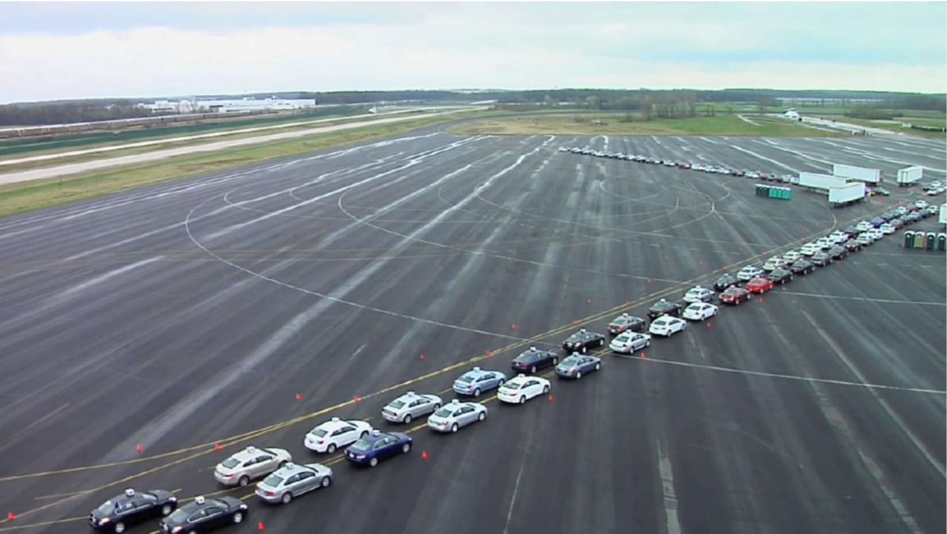
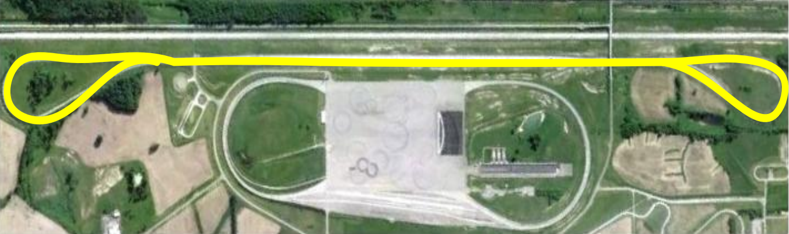
CAMP field test---phase 1
Field test scenario
  Phase 1 test:
    Up to 200 transceivers, each mounted on the roof of moving vehicles
    Six different driving configurations were tested
      Highway
      Intersection
      V2V Safety Application
      High Dynamics Winding Road
      Hidden Node
      Sudden loading effect
Notes:
1. six primary driving configurations were tested: Highway, intersection, V2V safety application, high dynamics winding
road, hidden node and sudden loading effect

Slide 9
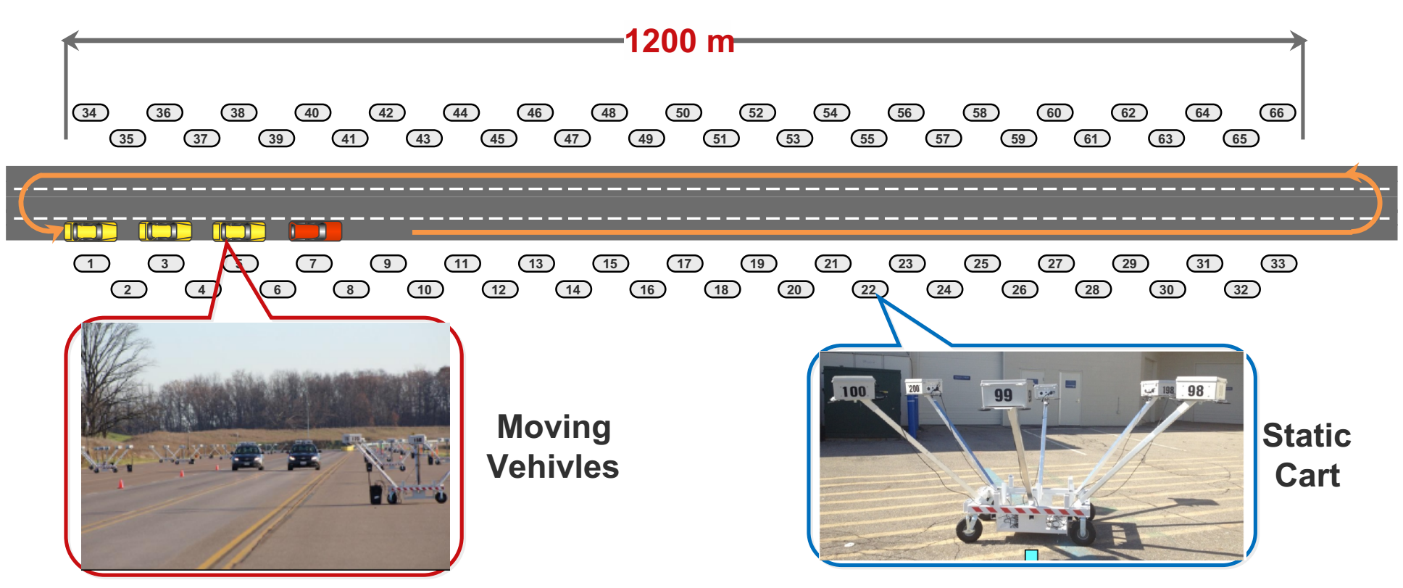
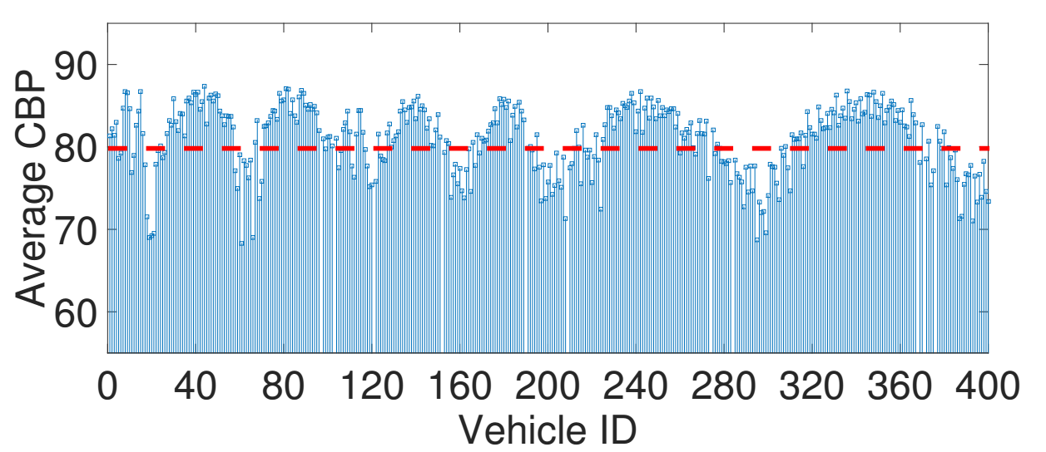
CAMP field test---phase 2
  Phase 2 test:
    In a relatively straightforward open-space environment
    Up to 400 transceivers: majority mounted on static carts, a small number mounted on moving vehicles
    66 static carts over 1200m
    Cart spacing: 37.5 m to the closest neighbor, 75 m to the neighbor on the same raw
    Vehicles drove between rows of carts with 75m spacing
Measured CBP
>80%
Notes:
Calibration effort

Slide 10
Simulator calibration
Calibrating four main components
  Transceiver mobility manager
    Decide the position and the movement of nodes in simulations
  Network traffic generator
    Decide what type of transmissions on the network and how they are generated
  Signal propagation
    Decide the received power of a signal at a receiver
  Receiver model
    Determine the reaction behaviors of a receiver when a signal arrives

Slide 11
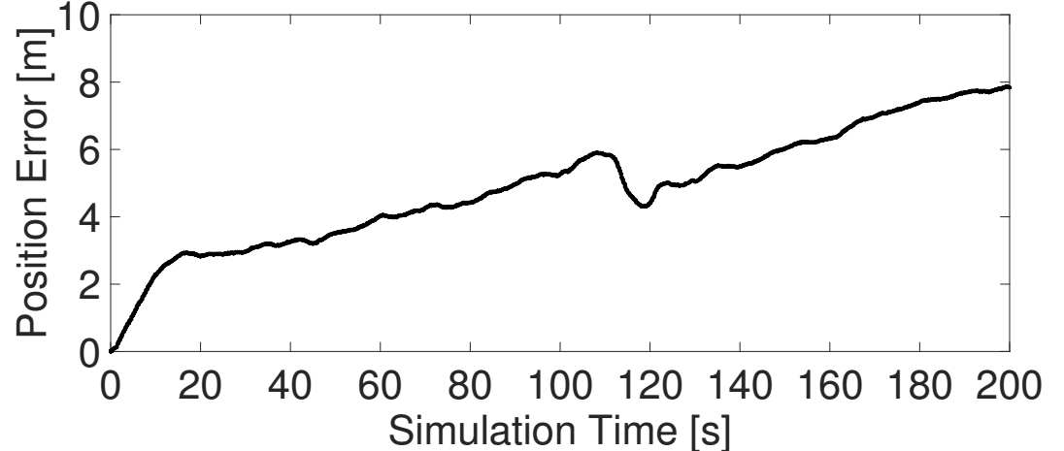
Transceiver mobility
A trace-driven approach
  Logging GPS coordinates 10 times per second
  Converting GPS coordinates into ns-3 readable trace format
    E.g.
      $ns_ at 0.1 "$node_(n₁) set X_ x₀"
      $ns_ at 0.1 “$node_(n₁) setdest x₁ y₁ inst_speed₀”
      $ns_ at 0.2 “$node_(n₁) setdest x₂ y₂ inst_speed₁”
  Relocate a node’s position in simulations to eliminate position error between trace reported position and extrapolated position

Slide 12
Network traffic generator
Periodically broadcast transmissions
CAMP hardware lab test results to determine
  Transmission power
  Noise floor
  CCA detection threshold
  Energy detection threshold
  Packet size: approximate to 316 Bytes
  Slot time
  AIFSN
  …

Slide 13
Signal propagation---modeling framework
RSSI = 10 log₁₀ p_{r (extracted from the logs)}
TXP = 10 log₁₀ p_{t (extracted from the logs)}
PL= RSSI - TXP= 10 log₁₀ g_{med} +10 log₁₀ F_{sh} + 10 log₁₀ F_{mp}
The distance-dependent loss captures how the average received power level varies with distance to the transmitter
The fading captures how the instantaneous signal level fluctuates over time and space.
Path Loss (in dBm)
distance-dependent loss
large-scale fading
small-scale
fading

Slide 14
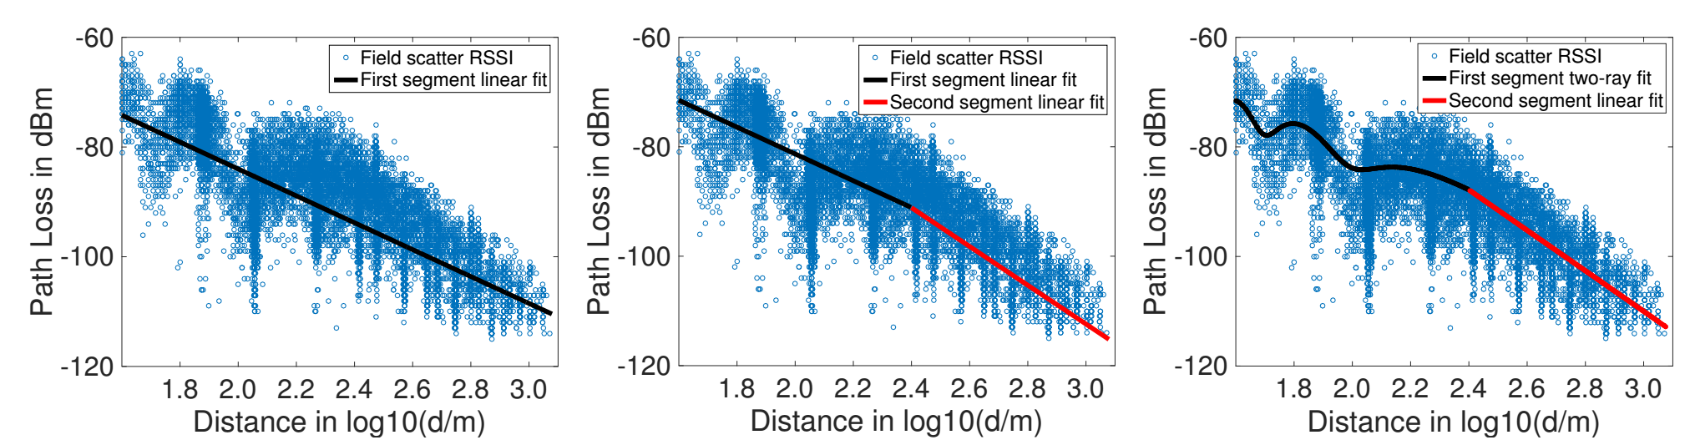
Signal propagation---model choices
Distance-dependent loss
  One-segment fit vs two-segment fit: propagation loss exponent increase with distance
  Log-distance (linear regression in dB domain) vs two-ray fitting: null effect
Two segment two ray fitting
10log₁₀ ((d0/d)²[A - B cos(2π(d’ – d)/λ)]) d≤d_{br}
A₂ – 10B₂log₁₀ (d)
Two segment fitting
A₁ – 10B₁log₁₀ (d) d≤d_{br}
A₂ – 10B₂log₁₀ (d)
One segment fitting A – 10B log₁₀ (d)
Break point
Null effect

Slide 15
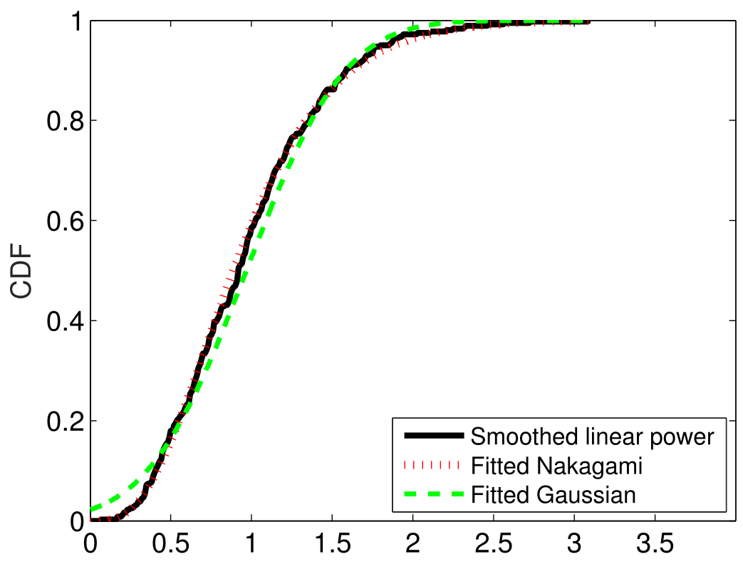
Signal propagation---model choices
  Fading:
    Equivalent to a Gaussian random variate with zero mean
    Standard deviation σ: least square error fitting of distance-dependent loss model to the data σ²= σ_{sh} ² + σ_{mp} ²
  Small-scale fading σ_{mp}:
    Nakagami is selected vs Gaussian as a better fit to the field test data
  Large-scale fading σ_{sh}:
    σ_{sh} ² = σ² - σ_{mp} ²

Slide 16
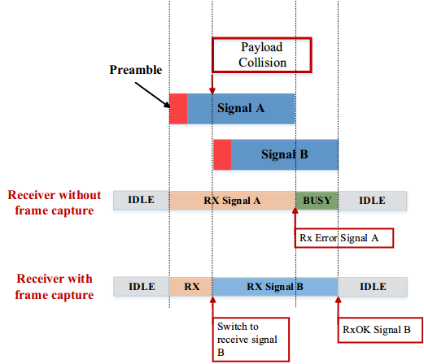
Receiver model---Frame capture effect
Frame capture
  Stronger signal B arrives later while the receiver is receiving a weak signal
  If signal B is strong enough, switch reception of weak signal A to signal B
  Signal B is received successfully

Slide 17
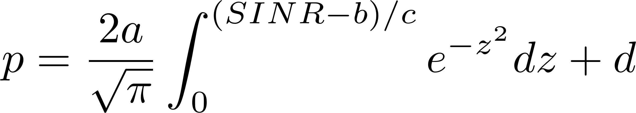
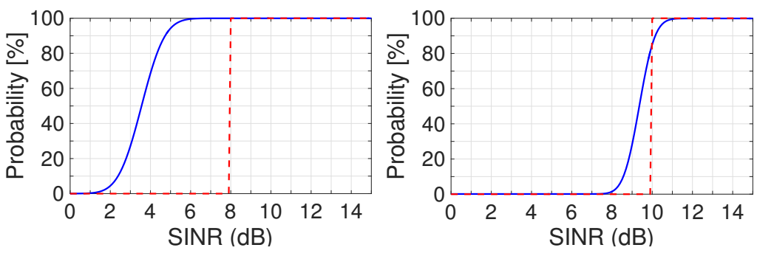
Receiver model---frame capture effect
Model implementation
  Based on ns-2 frame capture implementation logic
  Derive a set of probability-based models according to the CAMP hardware lab test
    Hardware lab test data indicate the relationship between SINR and successful decoding/capture probability
    Fitting the data to a error model:
Payload decoding model
Payload capture model
Blue line: fitted probability model
Red dash line for ns-2 threshold-based model

Slide 18
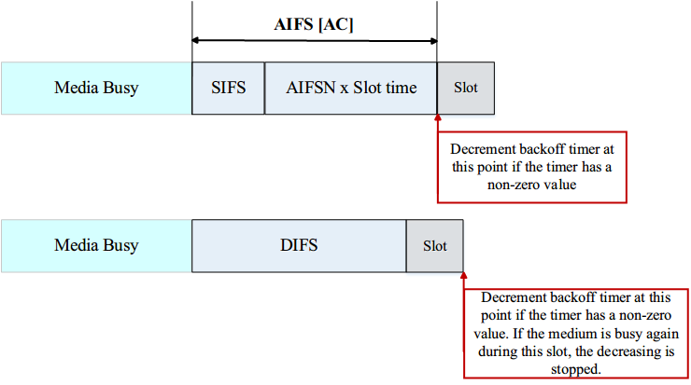
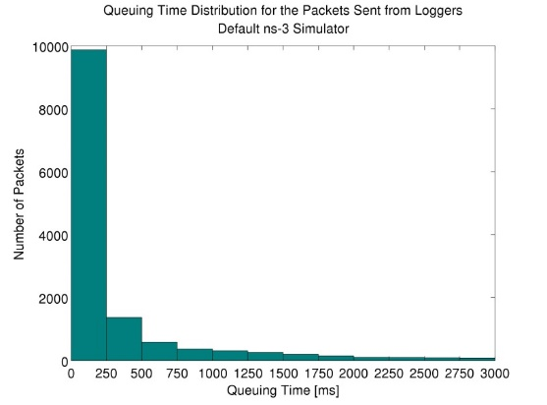
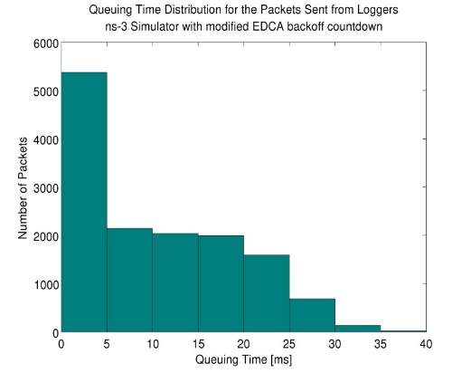
Receiver model---MAC layer correction
Backoff Time Countdown Correction
  According to the description of EDCA in IEEE 802.11 standard, the decrement of backoff timer counter should happen right after AIFS
  The default NS-3 starts to count down backoff timer counter after the channel is idle for at least one slot following a DIFS
  Generate significantly different results when the channel is busy
Simulation with 1800 nodes
EDCA
Default
largest queuing time is 3000 ms
Modified version
largest queuing time is 35 ms
DCF

Slide 19
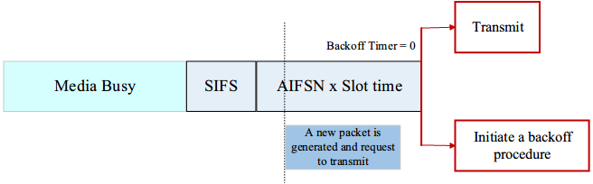
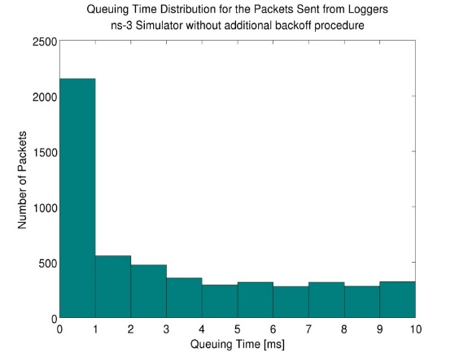
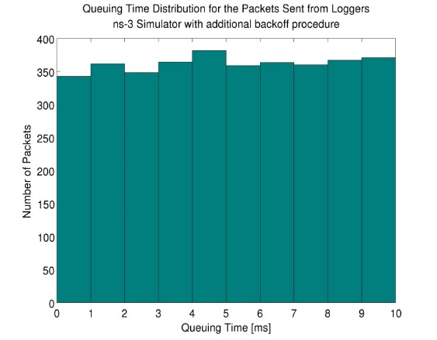
Receiver model---MAC layer correction
Additional Backoff Procedure
  If a station requests channel access during AIFS and its backoff timer counter is 0, should the transmission be granted immediately after AIFS or start backoff procedure?
  Start a new backoff procedure to mitigate the collision based on the suggestion from the CAMP experts
Simulation with 1800 nodes
Default
Many packets with very small queuing time
Modified version
queuing time almost uniformly distributed

Slide 20
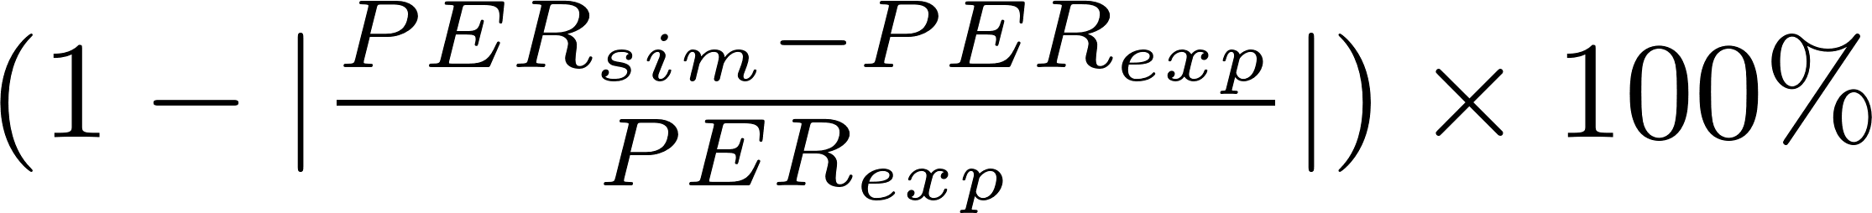
Calibration performance
Question to answer
  Impact of different simulator components on simulation accuracy, i.e., propagation models and receiver models
  Accuracy of well-calibrated models
Evaluation metrics
  PER
  IPG
  Simulation accuracy, e.g. for PER,

Slide 21
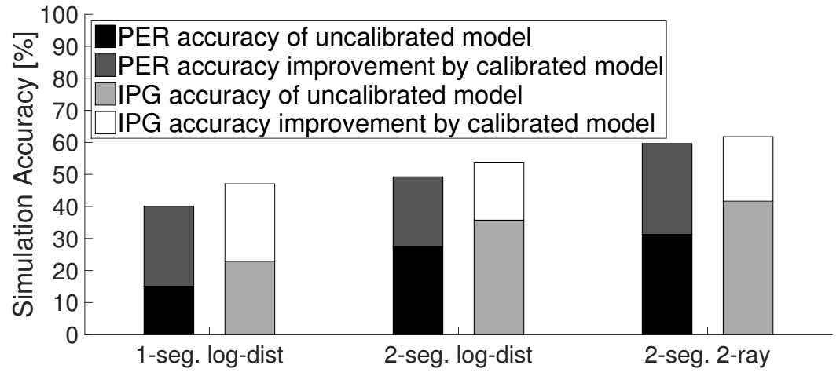
Impact of propagation model calibration
Three propagation models are tested
  Simulation accuracy increases ~20% after the calibration
  An uncalibrated model may only lead to 15% accuracy
28%
20%
18%
24%
21%
25%
15%

Slide 22
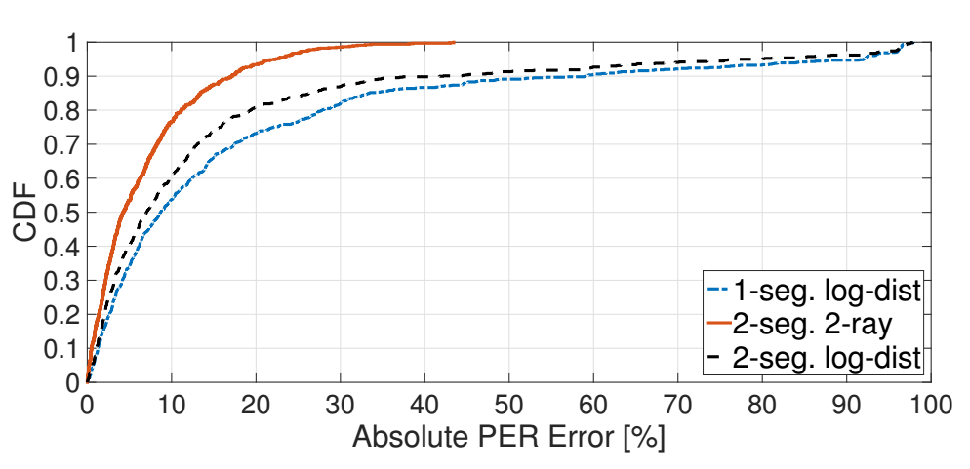
Impact of propagation model calibration
Link-level accuracy of calibrated models
  Largest error for 2-ray model is 43%, for log distance model is 98%
  Error less than 10%: 78% links for 2-ray model, 54% and 60% links for 1-segement and 2-segment log-distance models
10%
43%
98%

Slide 23
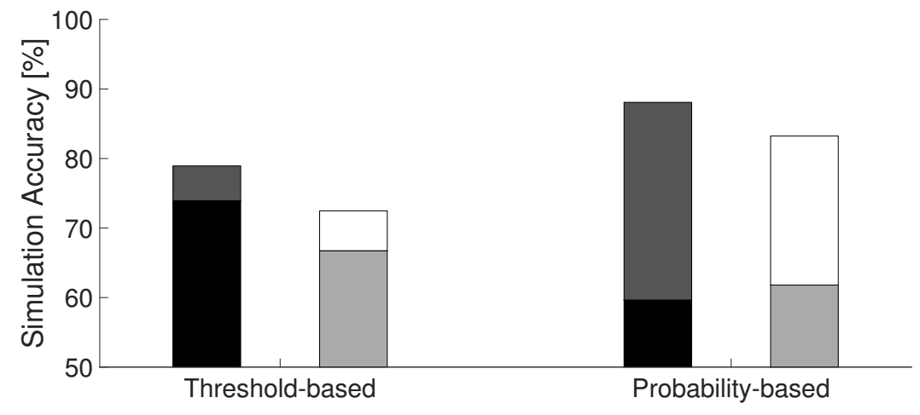
Impact of receiver model calibration
Threshold-based v.s. probability-based reception and capture model
  Calibrated model can introduce another ~20% increase in accuracy
  A well calibrated model can achieve 88% accuracy
Default ns-2 model
Default ns-3 model
88%
5%
29%
21%
6%

Slide 24
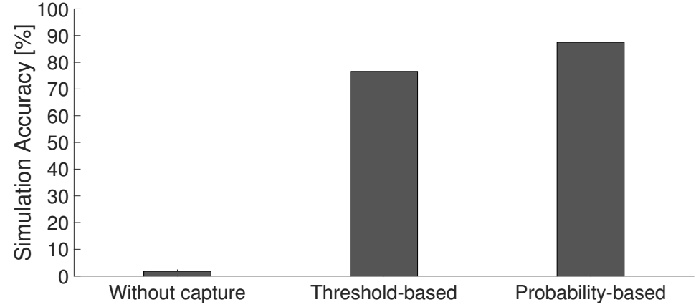
Impact of receiver model calibration
Frame capture of calibrated models
  Focus on the links with distance less than 100 m
  The implementation of the frame capture significantly affects the results
  The probability-based model can achieve 11% more accuracy
87%
76%
2%

Slide 25
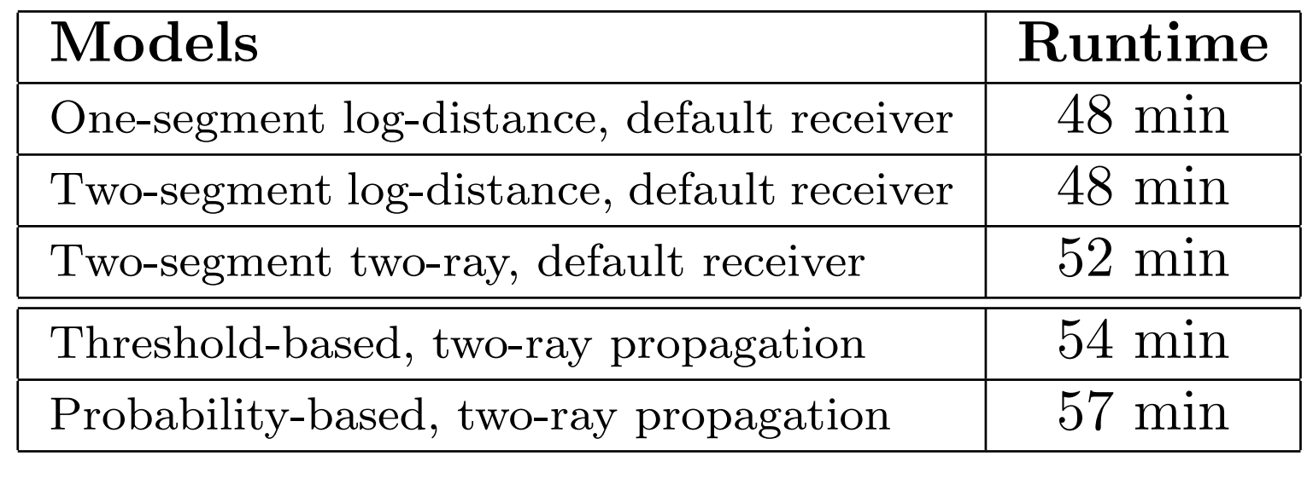
Simulation runtime
Simulation runtime of simulations with different models
  Simulation configurations
    400 nodes, transmission rate = 10 Hz
    Simulation time = 260 s
    On a machine with 2.4 GHz Intel Xeon E7 CPUs
  Models with different levels of complexity do not significantly increase runtime
  Ability to simulate much larger scale networks
    6000 nodes, transmission rate = 10 Hz, finish in 195 hours

Slide 26
Conclusion
The default propagation and receiver models were not able to produce a good match to the field experiment
With well-calibrated parameters and models from the literature, the simulation accuracy improves by ~ 20%
The stochastic simulation achieved 88% accuracy in term of PER in this scenario
A relatively small additional runtime overhead 8.7%

Slide 27
Thank You
Q&A

Slide 28
Backup slides

Slide 29
Introduction
New IEEE 802.11 ac standard potentially add 4 new 80 MHz and 3 new 160 MHz channels in 5 GHz band
  One 80 and one 160 MHz channel in DSRC 5.9 GHz band
DSRC is the technology selected for vehicle-to-vehicle communication
  Dedicated Short Range Communication (DSRC)
    Dedicated: 5.850-5.925 GHz licensed spectrum
    Short Range: Hundreds of meters
    Communication: Vehicle-to/from-X, where X =
      Another vehicle (V2V)
      Roadside infrastructure (V2I)
      Pedestrian, bicycle, train, …

Slide 30
Introduction
DSRC V2V safety concepts
  Each vehicle sends safety messages frequently
  Receiving vehicles assess collision threats
  Threats: Warns driver or take control of the vehicle
  High requirement in communication delay and packet loss
To evaluate the spectrum sharing between WiFi system and DSRC system, the performance of DSRC system should be studied first
  Network simulators remain as an import tool
    Low cost
    High flexibility

Slide 31
CAMP hardware lab test
The results of hardware testing were mainly used to determine the following thresholds and configurations:
  Noise floor;
  CCA detection threshold for OFDM signals;
  SINR for OFDM 6 Mbps channel for frame reception retention and frame capture.
  Time slots
  AIFSN

